Slide 1
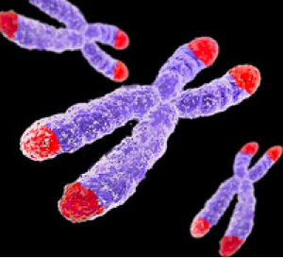
Does SmchD1 affect telomere compaction?
Volume of telomeres - How to look at it?
Sandwich Seminar
Verena Pfeiffer
Lingner lab
Notes:
Read:
SmchD1 paper X inactivation, DDR, DNA methylation, mice, plants
LRif1 paper
STORM principle, whitefield principle
DDR-TRF2 T-loop titia, TRF2 compaction in vitro

Slide 2
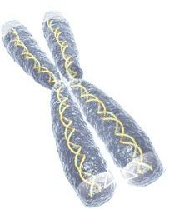
Telomeres in Homo sapiens
Function
Protects against end-to-end fusions
Telomerase solves the end-replication problem
Involved in chromosomal positioning
Involved in heterochromatin formation

Slide 3
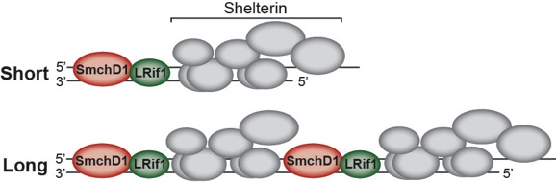
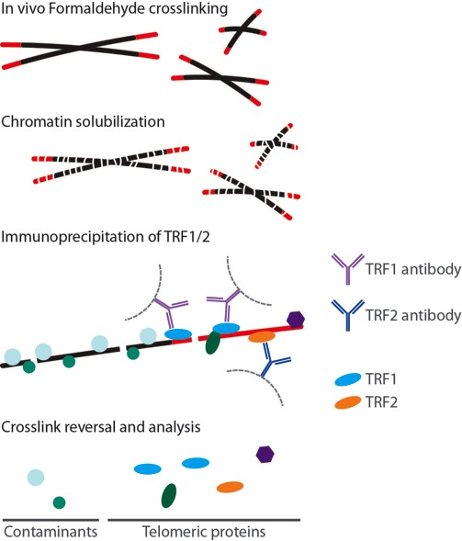
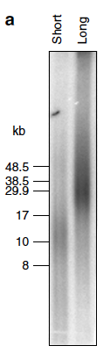
Q-TIP identifies novel proteins at long telomeres
Grolimund et al., Nat. Commun. 2013

Slide 4
Validation of increased presence of SmchD1 at long telomeres
Grolimund et al., Nat. Commun. 2013

Slide 5
What is the function of SmchD1 and LRif1 in Homo sapiens?
SmchD1
LRif1
DNA methylation/DNA structure
X chromosome inactivation
Hypermethylation/silencing of D4Z4
DNA damage repair
Diseases:
FSHD1/FSHD2
(facioscapulohumeral muscular dystrophy:
Mutations in D4Z4 and in SmchD1)
Repression of transcriptional activity of RARA
Repression through recruitment of HDACs
Notes:
SmchD1 is a member of the structural maintenance of chromosomes (SMC) protein family (higher order chromosome organization).
In DDR: is recruited to laser-induced micro-irradiation DDR and colocalizes with Ku80 and Rad51 (involved in NHEJ?). KD of SmchD1: more DDR breaks are not repaired, less 53BP1 recruitment.
SMC hinge domain in proteins involved in chromosome condensation, cohesion, segregation, and DNA recombination and repair. These proteins heterodimerize and bind DNA through the hinge domain.
What is the normal function of the SMCHD1 gene?
The SMCHD1 gene provides instructions for making a protein that is involved in regulating gene activity by altering the structure of DNA. Specifically, the SMCHD1 protein plays a role in DNA methylation, which is the addition of methyl groups (consisting of one carbon atom and three hydrogen atoms) to DNA molecules. The addition of methyl groups turns off (silences) genes, so hypermethylated regions of DNA tend to have fewer genes that are turned on (active).
The SMCHD1 protein is involved in a process called X-inactivation or Lyonization. Early in embryonic development in females, one of the two X chromosomes is randomly and permanently inactivated in cells other than egg cells. X-inactivation ensures that females, like males, have only one active copy of the X chromosome in each body cell. The SMCHD1 protein helps to inactivate the X chromosome by hypermethylating certain areas of DNA called CpG islands. The protein then remains attached (bound) to the inactive X chromosome to help keep it inactivated throughout life.
The SMCHD1 protein also plays a role in hypermethylation of a region near the end of chromosome 4 called D4Z4. This region consists of 11 to more than 100 repeated segments, each of which is about 3,300 DNA base pairs (3.3 kb) long. The segment closest to the end of chromosome 4 contains a gene called DUX4. Because the D4Z4 region is hypermethylated, the DUX4 gene is silenced in most adult cells and tissues. Little is known about the function of the protein produced from the DUX4 gene; it appears to help control the activity of other genes.
Studies suggest that the SMCHD1 gene is also involved in repairing damaged DNA. However, little is known about its role in this process.
How are changes in the SMCHD1 gene related to health conditions?
facioscapulohumeral muscular dystrophy - caused by mutations in the SMCHD1 gene More than a dozen mutations in the SMCHD1 gene have been found to cause facioscapulohumeral muscular dystrophy, a disorder characterized by muscle weakness and wasting (atrophy) that worsens slowly over time. Two forms of the disorder have been described: type 1 (FSHD1) and type 2 (FSHD2). Changes in the SMCHD1 gene appear to play a role in both types.
SMCHD1 gene mutations cause most cases of FSHD2. These mutations reduce the amount of SMCHD1 protein available to add methyl groups to the D4Z4 region. The resulting hypomethylation of this region prevents the DUX4 gene from being silenced in cells and tissues where it is usually turned off, such as adult muscle cells. However, hypomethylation of the D4Z4 region results in facioscapulohumeral muscular dystrophy only when it occurs in people who also have at least one copy of chromosome 4 that is described as "permissive." A "permissive" chromosome 4 has a functional region of DNA known as a pLAM sequence located next to the DUX4 gene. The pLAM sequence is necessary for the production of the DUX4 protein. (Conversely, a "non-permissive" chromosome 4 does not contain a functional pLAM sequence, preventing the production of any DUX4 protein.) Researchers believe that the DUX4 protein influences the activity of other genes, particularly in muscle cells. However, it is unknown how the presence of this protein damages or destroys these cells, leading to progressive muscle weakness and atrophy.
Studies suggest that mutations in the SMCHD1 gene can increase the severity of disease in people with the other type of facioscapulohumeral muscular dystrophy, FSHD1. FSHD1 results when the D4Z4 region is abnormally shortened (contracted), containing between 1 and 10 repeats instead of the usual 11 to 100 repeats. Researchers suspect that the combination of a contracted D4Z4 region and a SMCHD1 gene mutation causes the D4Z4 region to have even fewer methyl groups attached, which allows the DUX4 gene to be highly active. In people with both genetic changes, the overactive gene leads to severe muscle weakness and atrophy.
Where is the SMCHD1 gene located?
Cytogenetic Location: 18p11.32
Molecular Location on chromosome 18: base pairs 2,655,886 to 2,805,016
The SMCHD1 gene is located on the short (p) arm of chromosome 18 at position 11.32.
More precisely, the SMCHD1 gene is located from base pair 2,655,886 to base pair 2,805,016 on chromosome 18.
UniProtKB/Swiss-Prot: LRIF1_HUMAN, Q5T3J3Function: Represses the ligand-induced transcriptional activity of retinoic acid receptor alpha (RARA). This repression may occur through direct recruitment of histone deacetylases

Slide 6
Role of SmchD1 and LRif1 in X inactivation in Homo sapiens?
LRif1
LRif1
LRif1
LRif1
Nozawa et al., NSMB. 2013
Notes:
KD of SmchD1 and LRif1 results in the disappearance of the Barr body and reorganization of the H3K9me3 (but total amounts are not changed).

Slide 7
Question:
Are SmchD1 or LRif1 involved in telomere compaction?
How to measure telomere compaction?
Microscopy:
Compaction as a function of changes in size/volume?
Notes:
STORM buffer:
50mM Tris-HCl pH 8
Glucose 10%
10mM NaCl
Glucose oxidase 1% (84 U) (Glc + O2 = Glucose-lactate + H2O2)
Catalase (510 U) (2 H2O2 = O2 + 2 H2O)
COT (cyclooctatetraene) 2mM
Beta-ME 1%
Lasts only 15-30 min in open chamber due to pH decrease from the production of gluconic acid by glucose oxidase. Can be changed by adding 100 mM Tris.
Beta-Mw: increases the photoswitching of Cy5.
COT increases fluorescence brigthness.
(see Huang lab: http://craterlake.ucsf.edu:18080/cm/wiki/?id=360)
Fluorophores shuffle between flourescent state and dark state under low oxygen conditions, i.e. oxygen leads to photobleaching.

Slide 8
How can we assess the size/volume of short and long telomeres?
3D-STORM (Stochastic optical reconstruction microscopy)
DNA-FISH: Cy5-(CCCTAA)₃-PNA probe (18 nts)
Max amount of probes that can bind = max nb of localizations:
Hela short: 556
Hela long: 1389
conventional
STORM
Notes:
To visualize telomeres in fixed Hela cells, we employed a peptide nucleic acid (PNA) FISH probe that was complementary to the TTAGGG repeats and labeled with a photoswitchable dye. We used astigmatism-based three-dimensional (3D) STORM imaging to determine the x, y, and z coordinates of individual probes and to reconstruct images with a resolution of 20 nm in xy directions and 50 nm in the z direction.
Slides (10000 frames/image; 15 images/condition) were imaged on the Nikon super-resolution microscope in the BIOP using a cylindrical lens for 3D imaging. DNA-FISH was performed to label the telomeres with labels that were 18 nts long. The fluorophore was Cy5. Datasets were comprised of drift-corrected x-, y-, and z-coordinates of all localizations in an image. Localizations in which a molecule was on for ten consecutive frames or more were discarded before we received the dataset. (For the time being, we’ll count each fluorophore as a distinct molecule, but in the future this will have to change…)
Conventional microscopy limited resolution due to diffraction limit of light. STORM = superresolution = resolution to 1/10 of conventional whitefield (the resolution depends on the excitation wave length and the numerical aperature of the objective (Resolutinx,y = wavelength/2NA): still for conventional in x, y = 200-250nm in z 500 nm;
(confocal= 1.4x better resolution, but less good signal to noise ratio).
STORM = sequential and stochastic readout with precise localization of multiple single molecules from specimens that were fluorescently labeled with photoswitchable dyes.
Principle behind STORM is that the activated state of a photoswitchable molecule must lead to the consecutive emission of sufficient photons to enable precise localization before it enters a dark state or becomes deactivated by photobleaching. Additionally, the sparsely activated fluorescent molecules must be separated by a distance that exceeds the Abbe diffraction limit (in effect, greater than approximately 250 nanometers) to enable the parallel recording of many individual emitters, each having a distinct set of coordinates in the lateral image plane. The molecular coordinates are determined with a precision that is based on the number of emitted photons. Images of the emitters are captured using a low power readout laser (usually spanning from 1 to 3 camera frames) until they spontaneously photobleach or re-enter a dark state. Repeating this process for multiple cycles, each generating a stochastically unique subset of activated fluorophores, enables the positions of many fluorophores to be determined and a summed image to be reconstructed at the end of the experiment.
Basically, although the image of a single fluorescent emitter is manifested in a finite-sized spot having dimensions limited by diffraction when captured with a CCD-based camera, the precision with which the exact position of the molecule can be determined can be much higher (in the range of a few nanometers), provided enough photons are captured. This is due to the fact that each captured photon provides an independent measurement of the position, with the ultimate level of precision being directly proportional to the square root of the total number of measurements. A localization accuracy of approximately 10 nanometers can be achieved when the measured photon distribution of a fluorophore is approximately 1,000 photons and the background noise is negligible compared to the molecular signal. The most critical element in obtaining the high-precision results necessary for precise molecular localization in STORM imaging is to minimize the background noise while simultaneously maximizing photon output from the fluorescent probe. In one of the best case scenarios, if 10,000 photons can be gathered in the absence of background before the fluorophore either photobleaches or is switched off, the center of localization can be determined with an accuracy down to 1 to 2 nanometers. However, as lower numbers of photons are collected, the localization accuracy becomes increasingly less. Thus, if only 400 to 500 photons are measured, the accuracy drops to around 20 nanometers or worse. Therefore, the fluorescent probes chosen for STORM imaging should display a high contrast ratio, which is defined as the ratio of fluorescence emission before and after photoactivation or photoconversion.
Alexa Fluor 647 (a structural analog of Cy5 with similar photoswitching properties). Fluorescent probes suitable for imaging with STORM are those featuring very high brightness and contrast levels that yield the maximum number of photons per molecule before photobleaching or return to a dark, non-fluorescent state. The best probes for STORM imaging should exhibit spectral profiles for the active and inactive species that are sufficiently well separated and thermally stable so that spontaneous interconversion rates are very low compared to the light-controlled activation rate. Due to the fact that many of the fluorophores used in STORM imaging can be photoswitched, these probes should also exhibit high switching reliability, low fatigue rates, and switching kinetics that can be readily controlled. A wide spectrum of fluorophores that were originally thought to be photostable has since been demonstrated to enter dark states under low oxygen conditions in the presence of aliphatic thiols at moderate laser powers.
Cy5: peak excitation = 649nm, peak emission = 664 nm, molar extinction coefficient = 250 x10e3, quantum yield = 0.28, nb of photons emitted per molecule per switching cycle = 4000; excitation with red laser (633, 647, 657nm) generates fluorescence emission and can photoswitch to dye back to the dark state.
Among the critical aspects that must be considered for STORM are the accuracy of each individual localization measurement, the density of probes that have been localized in the final image (commonly termed molecular density), and the physical size of the labels themselves. The localization precision, in turn, is primarily dependent upon the number of photons collected from the fluorescent molecules during a single activation-deactivation cycle, provided the background noise is negligible.
In terms of temporal resolution, single-molecule based superresolution approaches do not directly generate an image, but rather are used to map specific molecular localizations that are determined from thousands of individual imaging frames. In this case, temporal resolution is determined by the number of imaging frames that are required to obtain a suitable image. Three-dimensional STORM imaging achieves a simultaneous lateral resolution of approximately 25 nanometers and an axial resolution approaching 50 nanometers over a range of 600 nanometers in the z direction without scanning the specimen, whereas implementing a scanning regime allows a specimen several micrometers in depth to be imaged.
Data by me:
11.06.14: Hela S and L
29.07.14: Hela S and L pSuper, pLVP041, pLVP042
05.08.14: Hela L siGfp, si1LRif1, si6LRif1
13.08.14: Hela S and L pSuper, pLVP041, pLVP042, Trf2-3

Slide 9
How can we assess the size/volume of telomeres?
How can we analyze the size of a telomere?
In STORM: telomere = a cluster of localizations
Determine variance of the localizations within one cluster (R_{G})
Draw shape around the localizations and measure volume of that shape
Problem: - Uncertainty in the labeling process
- Uncertainty in the measurement process
Kyle Douglass, Sacha Benke

Slide 10
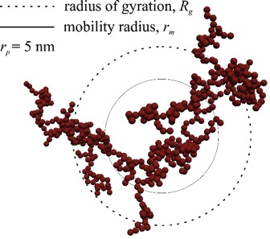
The radius of gyration is a measure of the size of a telomere
The information about the size of the telomere is represented
by the variance of its localizations
The variance of the localizations within a
cluster is a measure of its size.
=
Polymerphysics:
z
y
x
Raw data: set of points in 3D
Kyle Douglass, Sacha Benke
Notes:
Radius of gyration or gyradius is the name of several related measures of the size of an object, a surface, or an ensemble of points. It is calculated as the root mean square distance of the objects' parts from either its center of mass or a given axis.
http://paulbourke.net/miscellaneous/meanvar/
The standard error of the mean is defined as the standard deviation divided by the square root of the number of estimates.
The standard error of the sample is an estimate of how far the sample mean is likely to be from the population mean, whereas the standard deviation of the sample is the degree to which individuals within the sample differ from the sample mean. If the population standard deviation is finite, the standard error of the sample will tend to zero with increasing sample size, because the estimate of the population mean will improve, while the standard deviation of the sample will tend to the population standard deviation as the sample size increases.

Slide 11
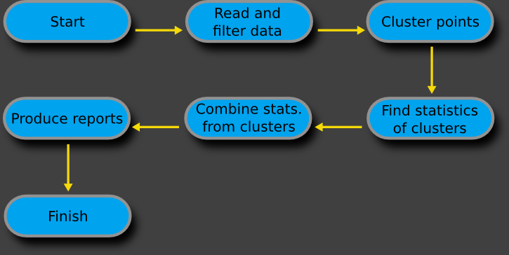
Algorithm to analyze the telomere 3D-STORM raw data
3D-STORM
raw data
=
List of localizations with coordinates in x, y, z
Size as: R_{G}
Kyle Douglass, Sacha Benke

Slide 12
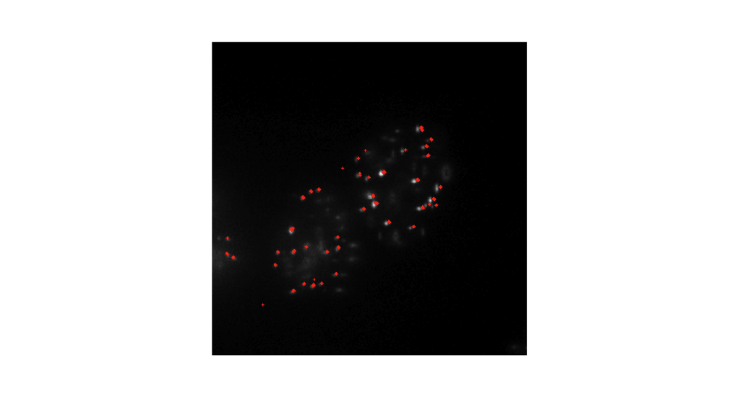
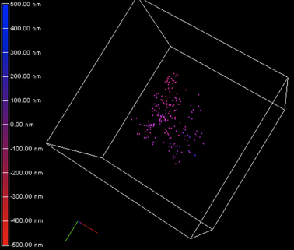
DBSCAN clustering captures and groups the localizations
Red: STORM
White: Whitefield
Cluster = telomere
Kyle Douglass, Sacha Benke
Notes:
k = 8 = number of objects in a neighborhood of an object (minimal number of objects considered as a cluster)
Eps = 65 = neighborhood radius, if not known avoid this parameter or put [] minLoc - Discard all clusters with localizations fewer than this number.
Min localizations = 50
Max localizations = 1000
Field of view: 256x256 pixels; 0.16µm/pixel = 40µm x 40µm view

Slide 13
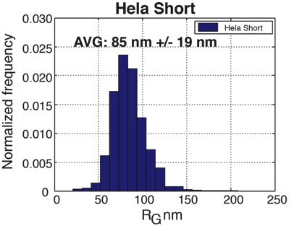
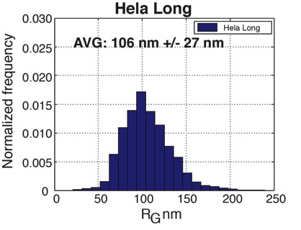
What is the size of short and long telomeres?
25 kb
10 kb
Notes:
Hela L clusters: 2424
Hela S cluster: 1441
Lateral localization precision = smaller than 10 nm (on average = 4 nm).
The Hela L telomeres fill more space in RG.
In super-resolution microscopy, the ‘monomers’ are the human telomere nucleotide repeat sequences. These sequences are randomly labeled with fluorescent molecules and recorded one a time.
The number of fluorescent molecules recorded in a telomere does not equal the total number of repeat sequences within the telomere. Furthermore, the average number of labeled sequences may be a nonlinear function of the number of sequences.
Our measured radius of gyration scales with an exponent that depends on both the telomere compaction and the labeling efficiency as a function of the number of repeat sequences.
bp = 0.34 nm in length
Cell: 2m of DNA
Hela L: 25kb = 8500 nm = 8.5µm (8500/106 nm) =1/80
Hela S: 10 kb = 3400 nm = 3.4 µm (3400/85 nm) = 1/40
PNA-telo probe = 18 nts (bp) = 6.12 nm
Titia de Lange: mouse telos: 20 +/- 7kb (EM), 10-50 kb (Southern), 184 nm diameter STORM
Pierron + Puvion-Dutilleul: Hela EM (protein removed): 120 nm diamter, 120 nm x 220 nm

Slide 14
How can we assess the size/volume of telomeres?
How can we analyze the size of a telomere?
In STORM: telomere = a cluster of localizations
Determine variance of the localizations within one cluster (R_{G})
Draw shape around the localizations and measure volume of that shape
Problem: - Uncertainty in the labeling process
- Uncertainty in the measurement process
Kyle Douglass, Sacha Benke

Slide 15
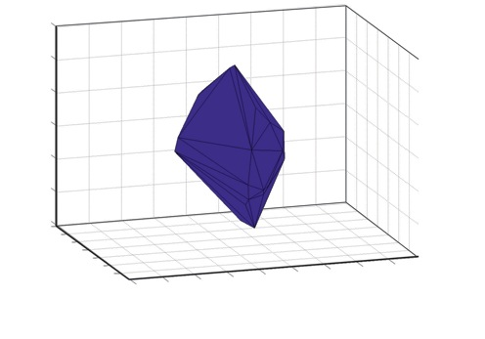
Convex hull determines the volume of a telomere
Raw data: set of points in 3D
The convex hull of a set of points is the smallest convex set that contains all the points of the cluster.
z
y
x
Convex hull
The volume of the polyhedron is defined
by a randomly distributed set of points in 3D.
Kyle Douglass, Sacha Benke

Slide 16
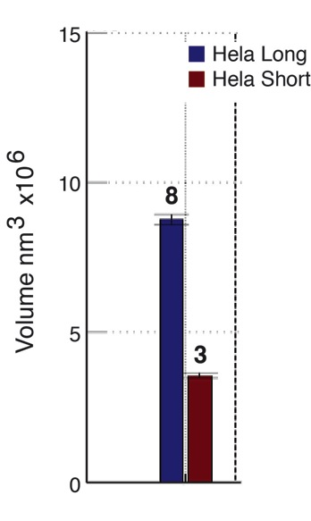
What is the volume of short and long telomeres?
0.008 +/- 0.0002 µm³
25 kb
Hela cell: 2000 µm³
Nucleus: 200 µm³
10 kb
0.003 +/- 0.0001 µm³
Notes:
23 chromosome pairs in human cell, i.e. 46 chromosomes, i.e. 92 telomeres
Haploid cell DNA content human: 3200 Mb
6% is repetitive DNA: 198 Mb
Haploid Hela telomeres short = 10 kb *46 chromosome ends = 460 kb = (460kb*100/198Mb) = 0.23% of repetitive DNA =0.014% of total DNA
Total Nucleus = 200µm3; 0.014% = 0.028 µm3 for all telomeres max. (our value: 0.003 µm3/telomere = 0.003*46 = 0.138µm3).
Given in the graph are the Standard errors, not the standard deviation. The standard error is the standard deviation divided by the cube root of the number of clusters.
The standard deviation of the cube root of the volume is about 30% of the actual cube root of the volume.
The Hela L telomeres fill more space in volume and in RG. (RG and volume scale on a linear scale, i.e. the bigger the RG the bigger the volume; not the case with localizations.)

Slide 17
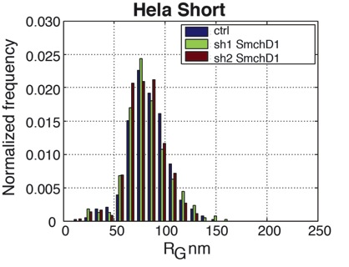
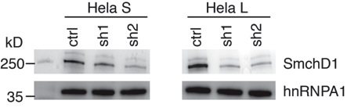
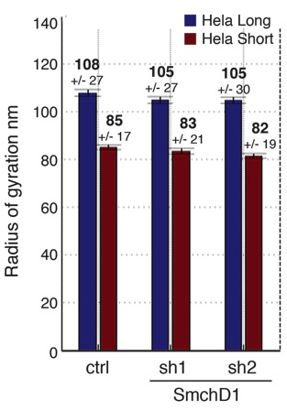
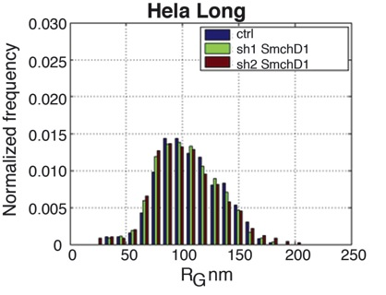
Does SmchD1 affect the size of short or long telomeres?
Notes:
Hela L ctrl clusters: 382
Hela L sh1 clusters: 355
Hela L sh2 clusters: 486
Hela S ctrl clusters: 370
Hela S sh1 clusters: 367
Hela S sh2 clusters: 363
Hela L ctrl clusters: 382
Hela L sh1 clusters: 355
Hela L sh2 clusters: 486

Slide 18
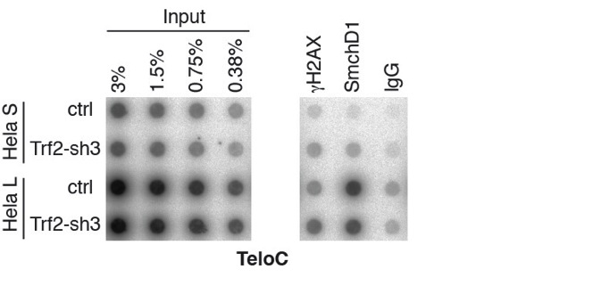
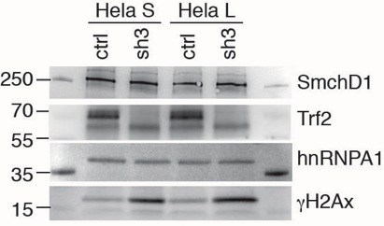
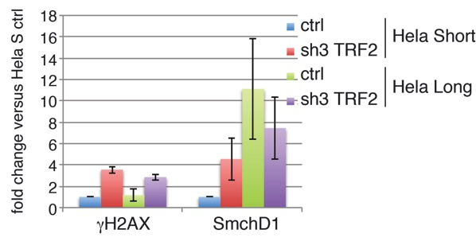
Does DNA damage affect presence of SmchD1 at telomeres?
Notes:
TRF2 KD induces classical Non-homologous end-joining and ATM signaling ( = cause of NHEJ; + loss of 3’overhang) = fusion of telos.
(Pot1 KD = ATR induction = increase of 3’overhang). (TRF1 KD = ATR induction, i.e. replication problems).
Recombinant TRF2 can remodel artificial telomeric DNA into t-loop structures and promotes supercoiling of DNA and strand invasion in vitro.
Size mouse telos EM = 20+/-6kb, Southern = 10-50kb (overestimation because of subtelomeric sequences); 25% are in T-loop configuration (is not affected by the presence or absence of ATM).

Slide 19
Facts
The size of a telomere can be determined by the R_{G}
The volume of a telomere can be determined by the convex hull
Hela Short have a R_{G} of 83 nm, Hela Long of 106 nm
SmchD1 KD under this conditions does not affect the telomere size
Outlook
Determine the function of SmchD1 in DDR
Notes:
-how can this entanglement be tested?
-looked at helicases or topoisomerases?

Slide 20
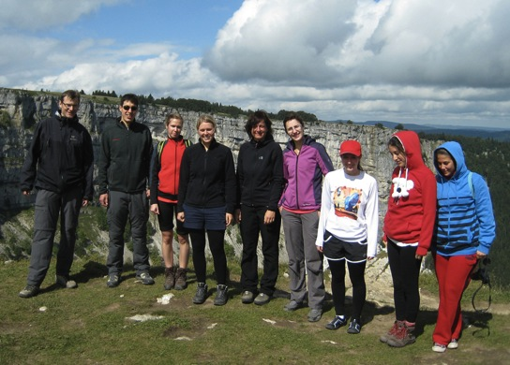
Thanks!
LEB
Suliana Manley
Kyle Douglass
Sacha Benke
BIOP
Arne Seitz
Mathias Fournier
Oliver Burri
Thierry Laroche
Joachim Lingner
Eric Aeby
Thomas Lunardi
Jana Majerskà
Patricia Renck Nunes
Sophie Redon
Anna-Sophia Reis
Aleksandra Vancevska

Slide 21
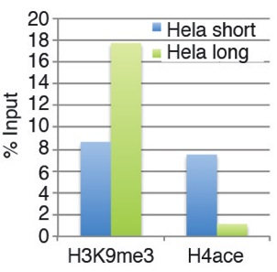
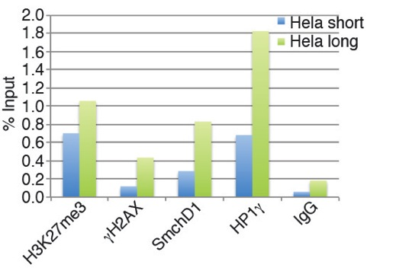
Do chromatin marks differ between short and long telomeres?

Slide 22
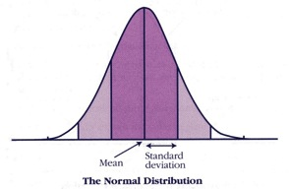
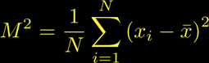

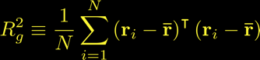
The variance of the points within a cluster is a measure of its size.
The second central moment of a distribution matches our physical intuition about size.
http://cnx.org/content/m16870/1.1/
In polymer physics, the sum of the mean square distances of the monomer units from the average position in x, y, and z is known as the
radius of gyration.
http://www3.aiche.org/proceedings/content/Annual-2011/images/Paper_233003_abstract_6042_0.jpg

